Slide 1
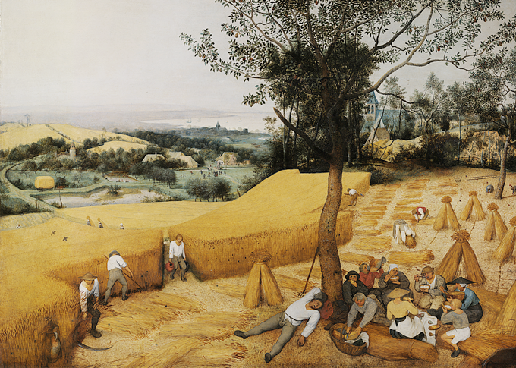
The Renaissance and Reformation (1300–1650)
Lesson 2 The Renaissance in Northern Europe

Slide 2
The Renaissance and Reformation (1300–1650)
Topic 4 Lesson 2 The Renaissance in Northern Europe
Learning Objectives
Describe the themes that northern European artists, humanists, and writers explored.
Explain how the printing revolution shaped European society.

Slide 3
Artists of the Northern Renaissance
Flemish Painters
Jan van Eyck portrayed townspeople as well as religious scenes using new techniques for oil painting that made them last for centuries
Pieter Bruegel painted lively scenes of peasant life, influencing later generations of Flemish artists
Albrecht Dürer: A “German Leonardo”
A German painter and printmaker, he traveled to Italy several times to study the works and techniques of Italian masters
He used this information in his paintings, engravings, and prints, helping to bring the Ren to Northern Europe
He is called the German Leonardo because of his wide range of interests

Slide 4
Artists of the Northern Renaissance
Analyze Information Pieter Bruegel painted this scene of Flemish working life called The Harvesters in 1565. What are some Renaissance characteristics of this painting?

Slide 5
Northern Renaissance Humanists and Writers
Erasmus
Dutch humanist, becomes a priest in 1492
Produces a new Greek edition of the New Testament and an improved Latin translation of the Bible
He calls for a translation of the Bible into the vernacular and for reform of the Catholic Church
Writes “In Praise of Folly” using humor to explore the ignorant immoral behavior of people
Sir Thomas More
English humanist who also pressed for social and economic reform
He writes Utopia, an ideal society where men and women live in peace and harmony. Private property does not exist. Everyone is educated.
Today utopian is used to describe any ideal society with the implication that such a society is impractical

Slide 6
Northern Renaissance Humanists and Writers
Rabelais’s Comic Masterpiece
A French humanist who was a monk, physician, Greek scholar, and an author
He wrote in French vernacular “Gargantua and Pantagruel” a story about travel and war but also discussing religion, education, and other serious subjects
Shakespeare Explores Universal Themes
English poet and playwright, between 1590-1613 he writes 37 plays that are still being performed around the world.
He writes comedies like A Midsummer Night’s Dream about the joys and follies of young people in love
He writes historical plays like Richard III chronicling the struggle between English kings
His tragedies show human beings being crushed by powerful forces or their own weakness. Examples include Romeo and Juliet and Macbeth
His work bring 1,700 new words into the English language

Slide 7
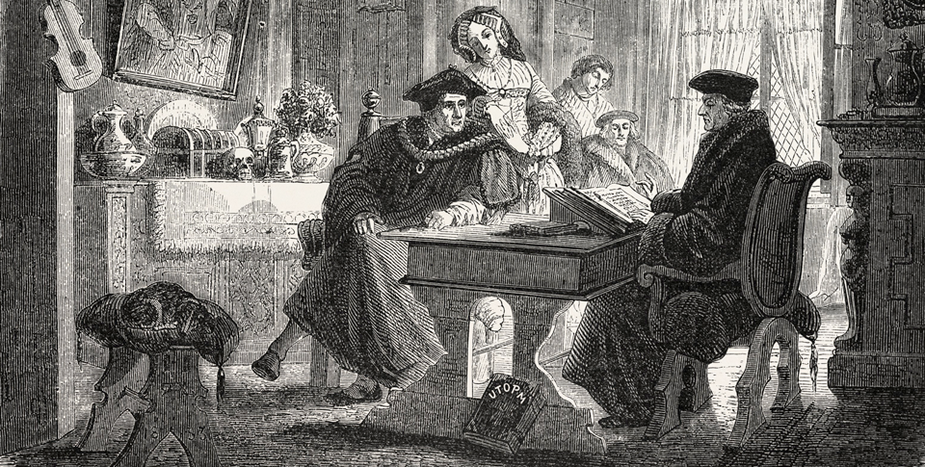
Northern Renaissance Humanists and Writers
Desiderius Erasmus was a Dutch priest and humanist scholar who was active during the Northern European Renaissance. He believed an individual's chief duties were to be open-minded and to show good will toward others.

Slide 8
The Printing Revolution
The New Technology
In 1456 Johannes Gutenberg in Germany printed the Christian Bible using a press with moveable type for the first time
This technology will move to Italy, the Netherlands, and England
Before the press there were a few thousands, by 1500 15 to 20 million, by the 1600’s between 150-200 million books
The Impact of the Printed Book
The price of books went dramatically down
More people learn to read and write
Educated Europeans are going to be exposed to new ideas that greatly expanded their horizons
The printing press contributes to the religious turmoil that is going to engulf Europe in the 1500’s
Because Christians can read the Bible for themselves, reformers will be able to spread ideas faster to a larger audience

Slide 9
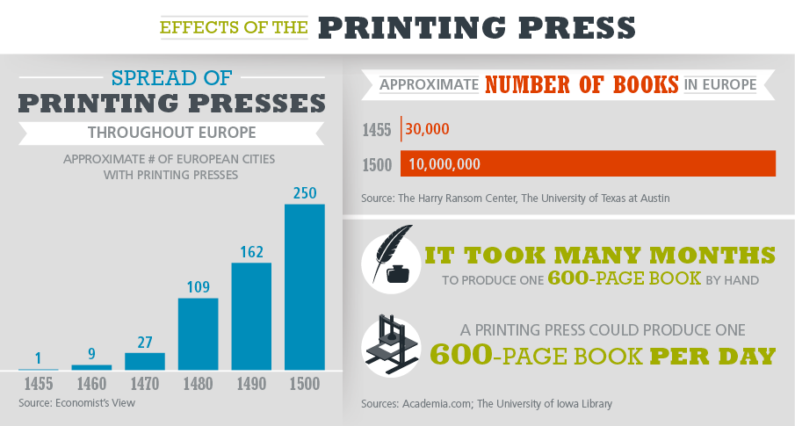
The Printing Revolution
Analyze Charts The chart shows the effects of the printing press in Europe. Is it likely or unlikely that in 1500, only the largest European capital cities had printing presses?

Slide 10
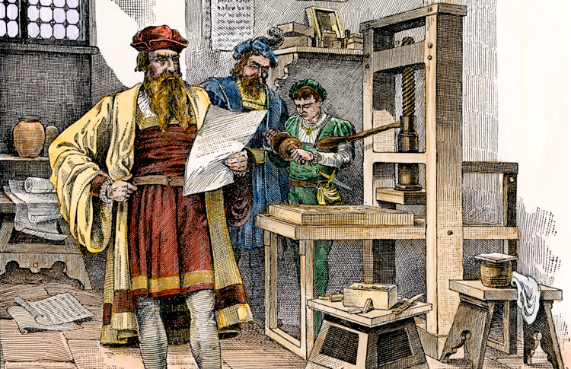
The Printing Revolution
Johannes Gutenberg with the first printing press in 1450s Mainz, Germany

Slide 11
Quiz: Artists of the Northern Renaissance
What Renaissance artistic theme appeared in the works of Van Eyck and Bruegel?
A. the rise of the merchant class
B. peasant life
C. poverty in the cities
D. religious scenes

Slide 12
Quiz: Northern Renaissance Humanists and Writers
What was a goal that the writers Erasmus, More, and Rabelais all had in common?
A. telling comical tales
B. translating biblical stories
C. changing and reforming society
D. abandoning old religions

Slide 13
Quiz: The Printing Revolution
What was one impact of the printing revolution on European society?
A. European readers learned classical languages as books became widely available.
B. More people had access to knowledge because books became less expensive.
C. Books were published in great numbers but were a luxury that only the wealthy could afford.
D. The printing press made books more elegantly designed than in the past.

